Slide 1
Verilog程序设计方法(1)

Slide 2
Outline
三种描述的举例说明
结构描述
数据描述
行为描述

Slide 3
Module Styles
Modules can be specified different ways
  Structural – connect primitives and modules
  Dataflow– use continuous assignments
  Behavioral – use initial and always blocks
  在模块和端口定义好以后，首先选择用哪种方法来描述。不同方式的难易程度不一样。
A single module can use more than one method!
What are the differences?

Slide 4
Structural Example
module majority (major, V1, V2, V3) ; //表决器，如果有两个输入是1，则输出为1；如果有两个输入是0，则输出为0。少数服从多数。
output major ;
input V1, V2, V3 ;
wire N1, N2, N3;//线网型声明
and A0 (N1, V1, V2),
A1 (N2, V2, V3),
A2 (N3, V3, V1);
or Or0 (major, N1, N2, N3);
endmodule
V1
N1
A0
V2
V2
A1
N2
Or0
major
V3
V3
A2
N3
V1
majority

Slide 5
Dataflow Example
module majority (major, V1, V2, V3) ;
output major ;
input V1, V2, V3 ;
assign major = V1 & V2
| V2 & V3
| V1 & V3;
endmodule
majority
V1
V2
major
V3

Slide 6
Behavioral Example
module majority (major, V1, V2, V3) ;
output reg major ;
input V1, V2, V3 ;
always @(V1, V2, V3) begin
if (V1 && V2 || V2 && V3
|| V1 && V3) major = 1;
else major = 0;
end
endmodule
majority
V1
V2
major
V3
Notes:
注意：必须output reg major 不能掉reg

Slide 7
Full Adder: Structural
module half_add (X, Y, S, C);
input X, Y ;
output S, C ;
xor SUM (S, X, Y);
and CARRY (C, X, Y);
endmodule
module full_add (A, B, CI, S, CO) ;
input A, B, CI ;
output S, CO ;
wire S1, C1, C2;
// build full adder from 2 half-adders
half_add PARTSUM (A, B, S1, C1),
SUM (S1, CI, S, C2);
// … add an OR gate for the carry
or CARRY (CO, C2, C1);
endmodule
Slide taken direct from Prof. Schulte

Slide 8
Full Adder: Dataflow/RTL
module fa_rtl (A, B, CI, S, CO) ;
input A, B, CI ;
output S, CO ;
// use continuous assignments
assign S = A ^ B ^ CI;
assign C0 = (A & B) | (A & CI) | (B & CI);
endmodule
Data flow Verilog is
often very concise
and still easy to read
Works great for most
boolean and even
datapath descriptions
Slide taken direct from Eric Hoffman

Slide 9
Full Adder: Behavioral
Circuit “reacts” to given events (for simulation)
  Actually list of signal changes that affect output
module fa_bhv (A, B, CI, S, CO) ;
input A, B, CI;
output S, CO;
reg S, CO; // assignment made in an always block
// must be made to registers
// use procedural assignments
always@(A or B or CI)
begin
S = A ^ B ^ CI;
CO = (A & B) | (A & CI) | (B & CI);
end
endmodule
Slide taken direct from Prof. Schulte

Slide 10
三种描述的特点
结构化描述：抽象级别最低，最接近于实际的硬件结构。
  缺点：随芯片的集成度越来越高，项目的复杂性越来越大，要想纯粹使用这种描述方式完成FPGA设计，已经不是人类所能做到的。
  优点：层次化的模块划分是FPGA设计思想的主流，父模块调用子模块的过程只能通过结构化的描述方式来实现。

Slide 11
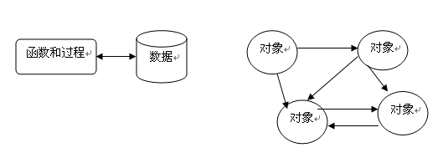
小知识（关于结构化）
1. 结构化程序设计（structured programming）是进行以模块功能和处理过程设计为主的详细设计的基本原则。其概念最早由E.W.Dijikstra在1965年提出的，是软件发展的一个重要的里程碑。它的主要观点是采用自顶向下、逐步求精及模块化的程序设计方法。
2. 结构化 vs 面向对象：结构化的缺点是模块由函数实现，完成对输入数据的加工和计算，数据和功能是分离的；如果数据的结构发生变化，相应的操作函数就不得不重新改写。而面向对象把数据和功能封装在对象中形成整体，通过对对象的管理和对象间的通讯实现软件功能。

Slide 12
三种描述的特点
结构化描述：抽象级别最低，最接近于实际的硬件结构。
  缺点：随芯片的集成度越来越高，项目的复杂性越来越大，要想纯粹使用这种描述方式完成FPGA设计，已经不是人类所能做到的。
  优点：层次化的模块划分是FPGA设计思想的主流，父模块调用子模块的过程只能通过结构化的描述方式来实现。
数据流描述：比结构化描述方式抽象级别要高一些，无需清晰地刻画出具体的数字电路，而直观地表达底层的逻辑行为。
  缺点：抽象级别远没有行为级描述高，所以只适用于小规模的电路设计。
  优点：既显式地表达了模块的行为，又隐式地刻画了模块的电路结构。因此对于功能较为简单的模块可以轻松利用数据流描述来实现，这样对设计者和编译器都方便；而对于复杂的模块，一般都是行为级描述为主，数据流描述方式为辅。

Slide 13
三种描述的特点
结构化描述：抽象级别最低，最接近于实际的硬件结构。
  缺点：随芯片的集成度越来越高，项目的复杂性越来越大，要想纯粹使用这种描述方式完成FPGA设计，已经不是人类所能做到的。
  优点：层次化的模块划分是FPGA设计思想的主流，父模块调用子模块的过程只能通过结构化的描述方式来实现。
数据流描述：比结构化描述方式抽象级别要高一些，无需清晰地刻画出具体的数字电路，而直观地表达底层的逻辑行为。
  缺点：抽象级别远没有行为级描述高，所以只适用于小规模的电路设计。
  优点：既显式地表达了模块的行为，又隐式地刻画了模块的电路结构。因此对于功能较为简单的模块可以轻松利用数据流描述来实现，这样对设计者和编译器都方便；而对于复杂的模块，一般都是行为级描述为主，数据流描述方式为辅。
行为描述：行为级描述方式的抽象级别更高，概括力更强，因此规模稍微大些的设计，往往都以行为级描述方式为主。

Slide 14
三种描述的特点
结构化描述方式直接给出底层电路结构，数据流描述方式间接给出底层电路结构，而行为级描述方式几乎就不给出底层电路结构。
无论采用何种描述方式，这中间的工作量是一致的，只不过不同的描述方式分配给人脑和电脑的工作量不同而已。

Slide 15
。

Slide 16
Outline
三种描述的举例说明
结构描述
  原语
数据描述
行为描述

Slide 17
Structural Basics: Primitives
Build design up from the gate/flip-flop/latch level
  Structural verilog is a netlist of blocks and connectivity
Verilog provides a set of gate primitives
  and, nand, or, nor, xor, xnor, not, buf, bufif1, etc.
  Combinational building blocks for structural design
  Cannot access “inside” description

Slide 18

小知识（关于原语Primitives）
原语：计算机用语范畴，常见于操作系统或计算机网络。由若干个机器指令构成的完成某种特定功能的一段程序，具有不可分割性：即原语的执行必须是连续的，在执行过程中不允许被中断。比如，操作系统层面上的“原语”（比如 write 之类的系统调用）对程序员来讲的确是不可分割的最小单位
除了“石头”是原语，而“剪刀”和“布头”不算，因为剪刀和布头都是人工合成的，而石头是浑然天成的。我们看到一把剪刀以后很容易想到它的各个组成部分（比如锋利的部分用铁制成，而握的地方用塑料），而看到一块石头以后，脑子里还是只有一块石头。
Notes:
原因是在人类形成最早语言的过程中还不知道什么是矿物质，众所周知人类的视力其实是很差的，只能看到光谱上面很小的一段可见光，也不能像显微镜一样看见的东西，直到道尔顿发现原子，人类科学才算走上了正轨。
计算机是一门人造科学，因此真正意义上的“原语”是不存在的。操作系统层面上的“原语”（比如 write 之类的系统调用）对程序员来讲的确是不可分割的最小单位，但是这写系统调用本身还是用好几句汇编语句组成的（对于 Linux 来说是 C 语言）。可能有人要说到了机器代码这一级就不能再分了，但事实上一条机器指令也是由好几个组合逻辑信号构成的。同样的道理，控制信号也不过是无数电子在器件内部漂移的结果。
因此定义“原语”的前提是观察者所处的位置。一旦规定了观察者的位置和观察的角度，比如就在操作系统的这层上，read，wirte，wait这些个系统调用自然就是最“原始”的词汇，这也是为什么“原语”会在操作系统中频繁出现的缘故。

Slide 19
Primitives
No declarations - can only be instantiated
Output port appears before input ports
Optionally specify: instance name and/or delay (discuss delay later)
and N25 (Z, A, B, C); // name specified
and #10 (Z, A, B, X),
(X, C, D, E); // delay specified, 2 gates
and #10 N30 (Z, A, B); // name and delay specified

Slide 20
Outline
三种描述的举例说明
结构描述
  原语
  语法
数据描述
行为描述

Slide 21
Syntax For Structural Verilog
First declare the interface to the module
  Module keyword, module name
  Port names/types/sizes
Next, declare any internal wires using “wire”
  wire [3:0] partialsum;
Then instantiate the primitives/submodules
  Indicate which signal is on which port

Slide 22
Outline
三种描述的举例说明
结构描述
  原语
  语法
  分层/模块化
数据描述
行为描述

Slide 23
Hierarchy
Interface (“black box” representation)
  Module name, ports
Definition
  Describe functionality of the block
Instantiation
  Use the module inside another module

Slide 24
模块
无论多么复杂的系统，总能划分成多个小的功能模块。系统的设计可以按照下面三个步骤进行：
（1）把系统划分成模块；
（2）规划各模块的接口；
（3）对模块编程并连接各模块完成系统设计。
模块的结构：
module <模块名>（<端口列表>）；
<定义>：一段程序，用来指定数据对象为寄存器型、存储器型、线型以及过程块，诸如函数块和任务块；
<模块条目>：一段程序，将上面<定义>和<端口>组合起来，是说明这个模块要做什么的语句；
endmodule

Slide 25
模块
模块的调用：
1）引用时，严格按照模块定义的端口顺序来连接，不用标明原模块定义时规定的端口名。
Design u_1(u_1的端口1，u_1的端口2，……)；
2）引用时用”.”符号，标明原模块定义时规定的端口名， 这样当被调用的模块管脚改变时不易出错。
Design u_2( .(端口1(u_1的端口1),
.(端口2(u_1的端口2),
…… );
eg.
module and (C,A,B);
input A,B;
output C;
...
and A1 (T3,A,B); //实例化时采用位置关联，T3对应输出端口C，A对应A，B对应B。
and A2 ( .C(T3),
.A(A),
.B(B) )；//实例化时采用名字关联，.C是and器件的端口，其与信号T3相连

Slide 26
Hierarchy
Build up a module from smaller pieces
  Primitives
  Other modules (which may contain other modules)
Design: typically top-down
Verification: typically bottom-up
Full Adder Hierarchy
Add_full
Add_half
Add_half
or
xor
and
xor
and

Slide 27
Add_half Module
Add_half
xor
and
module Add_half(c_out, sum, a, b);
output sum, c_out;
input a, b;
xor sum_bit(sum, a, b);
and carry_bit(c_out, a, b);
endmodule

Slide 28
Add_full Module
Add_full
Add_half
Add_half
or
module Add_full(c_out, sum, a, b, c_in) ;
output sum, c_out;
input a, b, c_in;
wire w1, w2, w3;
Add_half AH1(.sum(w1), .c_out(w2), .a(a), .b(b));
Add_half AH2(.sum(sum), .c_out(w3), .a(c_in), .b(w1));
or carry_bit(c_out, w2, w3);
endmodule
.sum 是引用的写法，这样的话，可以在参数引入的时候不用管顺序
Notes:
.sum 是引用的写法，这样的话，可以在参数引入的时候不用管顺序

Slide 29
Add_full Module
Add_full
Add_half
Add_half
or
Add_half AH1(.sum(w1), .c_out(w2), .a(a), .b(b));
最好写成
Add_half AH1(
.sum(w1),
.c_out(w2),
.a(a),
.b(b)
);

Slide 30
Can Mix Styles In Hierarchy!
module Add_half_bhv(c_out, sum, a, b);
output reg sum, c_out;
input a, b;
always @(a, b) begin
sum = a ^ b;
c_out = a & b;
end
endmodule
module Add_full_mix(c_out, sum, a, b, c_in) ;
output sum, c_out;
input a, b, c_in;
wire w1, w2, w3;
Add_half_bhv AH1(.sum(w1), .c_out(w2),
.a(a), .b(b));
Add_half_bhv AH2(.sum(sum), .c_out(w3),
.a(c_in), .b(w1));
assign c_out = w2 | w3;
endmodule

Slide 31
Hierarchy And Source Code
Can have all modules in a single file
  Module order doesn’t matter!
  Good for small designs
  Not so good for bigger ones
  Not so good for module reuse (cut & paste)
Can break up modules into multiple files
  Helps with organization
  Lets you find a specific module easily
  Good for module reuse (add file to project)

Slide 32
Structural Verilog: Connections
Positional or Connect by reference
  Can be okay in some situations
    Designs with very few ports
    Interchangeable input ports (and/or/xor gate inputs)
  Gets confusing for large #s of ports
module dec_2_4_en (A, E_n, D);
input [1:0] A;
input E_n;
output [3:0] D;
.
.
.
wire [1:0] X;
wire W_n;
wire [3:0] word;
// instantiate decoder
dec_2_4_en DX (X, W_n, word);
Partial code instatiating decoder

Slide 33
Structural Verilog: Connections
Explicit or Connect by name method
  Helps avoid “misconnections”
  Don’t have to remember port order
  Can be easier to read
  .<port name>(<signal name>)
wire [1:0] X;
wire W_n;
wire [3:0] word;
// instantiate decoder
dec_2_4_en DX (.A(X), .E_n(W_n), .D(word));
module dec_2_4_en (A, E_n, D);
input [1:0] A;
input E_n;
output [3:0] D;
  .
  .
  .
Partial code instatiating decoder

Slide 34
Empty Port Connections
Example: module dec_2_4_en(A, E_n, D);
  dec_2_4_en DX (X[1:0], , word); // E_n is high impedence (z)
  dec_2_4_en DX (X[1:0], W_n , ); // Outputs D[3:0] unused.
General rules
  Empty input ports => high impedance state (z)
  Empty output ports => output not used
Specify all input ports anyway!
  Z as an input is very bad…why?
Helps if no connection to output port name but leave empty:
  dec_2_4_en DX(.A(X[3:2]), .E_n(W_n), .D());

Slide 35
Outline
三种描述的举例说明
结构描述
数据描述
行为描述

Slide 36
Dataflow Verilog
The continuous assign statement
  It is the main construct of Dataflow Verilog
  It is deceptively powerful & useful
Generic form:
assign [drive_strength] [delay] list_of_net_assignments;
Where:
list_of_net_assignment ::= net_assignment [{,net_assignment}]
& Where:
Net_assignment ::= net_lvalue = expression
OK…that means just about nothing to me…how about some examples?

Slide 37
Continuous Assign Examples
Simplest form:
  // out is a net, a & b are also nets
  assign out = a & b; // and gate functionality
Using vectors
  wire [15:0] result, src1, src2; // 3 16-bit wide vectors
  assign result = src1 ^ src2; // 16-bit wide XOR
Can you implement a 32-bit adder in a single line?
  wire [31:0] sum, src1, src2; // 3 32-bit wide vectors
  assign {c_out,sum} = src1 + src2 + c_in; // wow!
Notes:
一条语句就可以做一个全加器！！WoW！

Slide 38
Back to the Continuous Assign
More basic generic form:
assign <LHS> = <RHS expression>;
If RHS result changes, LHS is updated with new value
  Constantly operating (“continuous”)
  It’s hardware!
  RHS can use operators (i.e. +,-,&,|,^,~,>>,…)
src1[31:0]
src2[31:0]
c_in
➔
assign {c_out,sum} = src1 + src2 + c_in;
c_out
sum[31:0]

Slide 39
Lets Kick up the Horse Power
You thought a 32-bit adder in one line was powerful. Lets try a 32-bit MAC…
Design a multiply-accumulate (MAC) unit that computes
Z[31:0] = A[15:0]*B[15:0] + C[31:0]
It sets overflow to one, if the result cannot be represented using 32 bits.
module mac(output [31:0] Z, output overflow,
input [15:0] A, B, input [15:0] C);

Slide 40

Lets Kick up the Horse Power
module mac(output [31:0] Z, output overflow,
input [15:0] A, B, input [31:0] C);
assign {overflow, Z} = A*B + C;
endmodule
I am a brilliant genius. I am a HDL coder extraordinaire. I created a 32-bit MAC, and I did it in a single line.
assign {overflow, Z} = A*B + C;
Oh my god, I’ve created a monster
Synopsys
Notes:
有时候机器对数据流进行翻译的时候，有可能会变成很大的电路。
所以有时候即使功能是正确的，但电路很可能还是很负责。

Slide 41
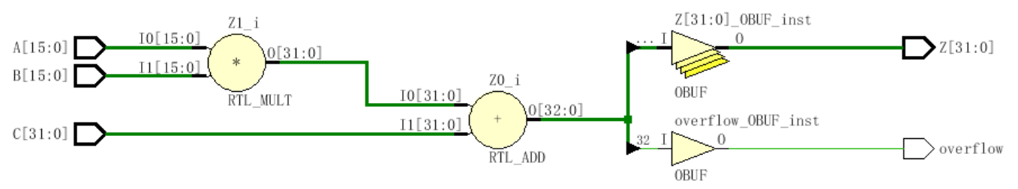
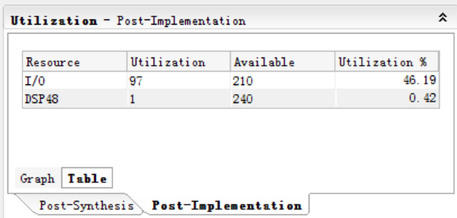
module mac(output [31:0] Z, output overflow,
input [15:0] A, B, input [31:0] C);
assign {overflow, Z} = A*B + C;
endmodule

Slide 42
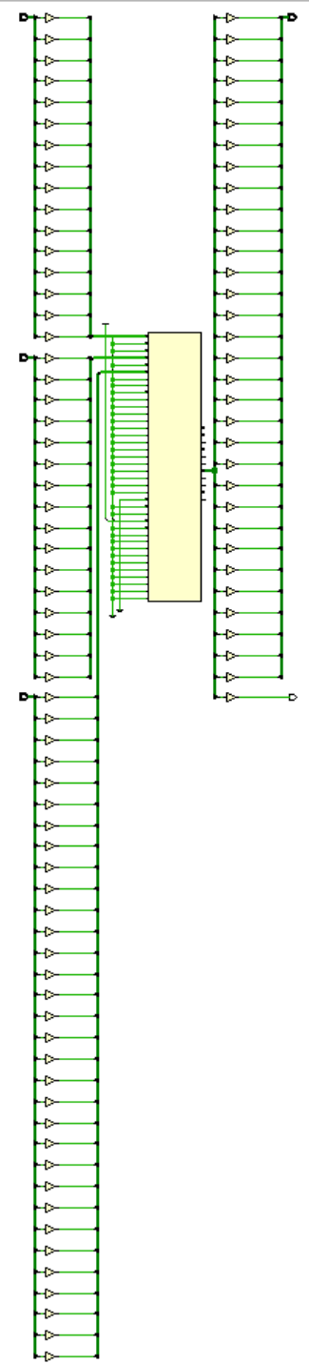
Notes:
Dsp模块很庞大，可以查表得到

Slide 43
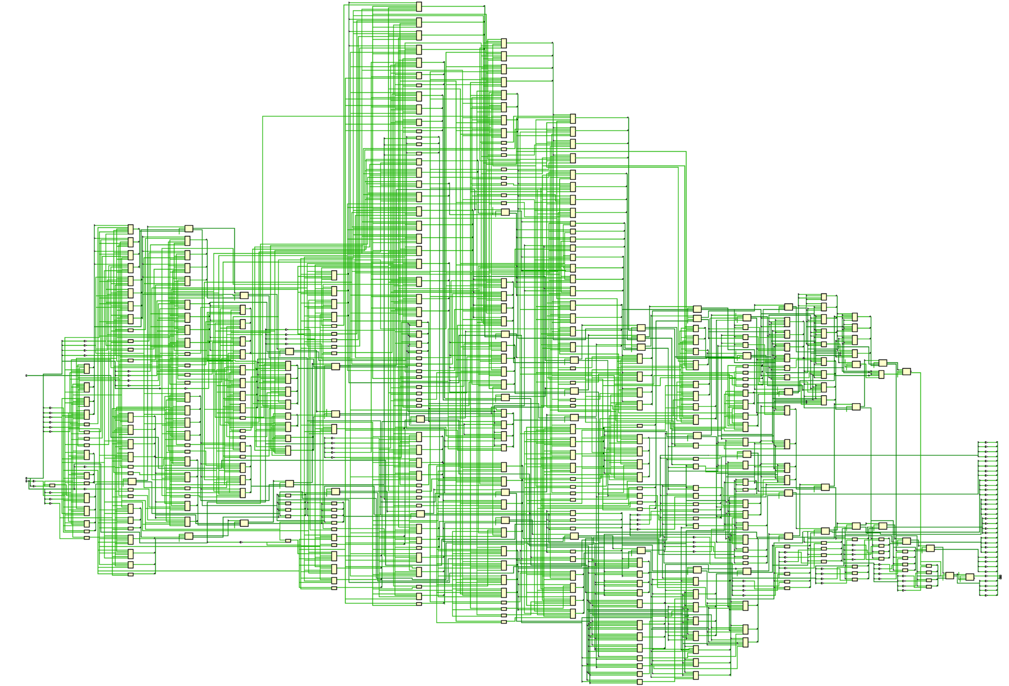

Slide 44
Outline
三种描述的举例说明
结构描述
数据描述
行为描述
  Initial

Slide 45
Behavioral Verilog
initial and always form basis of all behavioral Verilog
  All other behavioral statements occur within these
  initial and always blocks cannot be nested
  All <LHS> assignments must be to type reg
initial statements start at time 0 and execute once
  If there are multiple initial blocks they all start at time 0 and execute independently. They may finish independently.
If multiple behavioral statements are needed within the initial statement then the initial statement can be made compound with use of begin/end
Notes:
行为描述是用的最多的！！！
Initial 只会执行一次，用于初始化
Always 会反复执行，用于初始化后的执行
需要一个在两者之间的切换，需要驱动逻辑来选择，否则会冲突。
简单的方法是，一个电路只有一个驱动。
所以initial一般是不存在的，免得设置多个驱动。以后不要用initial来初始化。对于实验3的存储器，可以用initial来初始化。
Initial最好的地方是测试程序，因为测试程序用一次就完了。设计程序必须用always。
组合电路没有初始化，时序电路需要初始化，可以用置位和复位的方法来实现，而不用initial

Slide 46
More on initial statements
Initial statement very useful for testbenches
Initial statements don’t synthesize

Slide 47
initial Blocks
`timescale 1 ns / 100 fs
module full_adder_tb;
reg [3:0] stim;
wire s, c;
full_adder(sum, carry, stim[2], stim[1], stim[0]); // instantiate DUT
// monitor statement is special - only needs to be made once,
initial $monitor(“%t: s=%b c=%b stim=%b”, $time, s, c, stim[2:0]);
// tell our simulation when to stop
initial #50 $stop;
initial begin // stimulus generation
for (stim = 4’h0; stim < 4’h8; stim = stim + 1) begin
#5;
end
end
endmodule
all initial blocks start at time 0
multi-statement block enclosed by begin and end

Slide 48
Another initial Statement Example
module stim()
reg m,a,b,x,y;
initial
m = 1’b0;
initial begin
#5 a = 1’b1;
#25 b = 1’b1;//再过25个时间单位
end
initial begin
#10 x = 1’b1;
#25 y = 1’b1;
end
initial
#50 $finish;
endmodule
Time
Event
0
m = 1’b0
5
a = 1’b1
Modelsim
10
x = 1’b1
30
b = 1’b1
35
y = 1’b1
50
$finish
What events at what times will a verilog simulator produce?
Notes:
Initial默认从0时刻开始起作用
initial
#50 $finish;
Finish结束仿真
阻塞式赋值
#5 a = 1’b1;
#25 b = 1’b1;
a赋值完了以后，才会赋值给b

Slide 49
Outline
三种描述的举例说明
结构描述
数据描述
行为描述
  Initial
  always

Slide 50
always statements
Behavioral block operates CONTINUOUSLY
  Executes at time zero but loops continuously
  Can use a trigger list to control operation; @(a, b, c)
  In absense of a trigger list it will re-evaluate when the last <LHS> assignment completes.
module clock_gen (output reg clock);
initial
clock = 1’b0; // must initialize in initial block
always // no trigger list for this always
#10 clock = ~clock; // always will re-evaluate when
// last <LHS> assignment completes
endmodule
Notes:
Always有时候要在事件描述有效的时候，才能触发输入和输出。
always
#10 clock = ~clock;
这个是周期为20的时钟。这里没有条件触发。

Slide 51
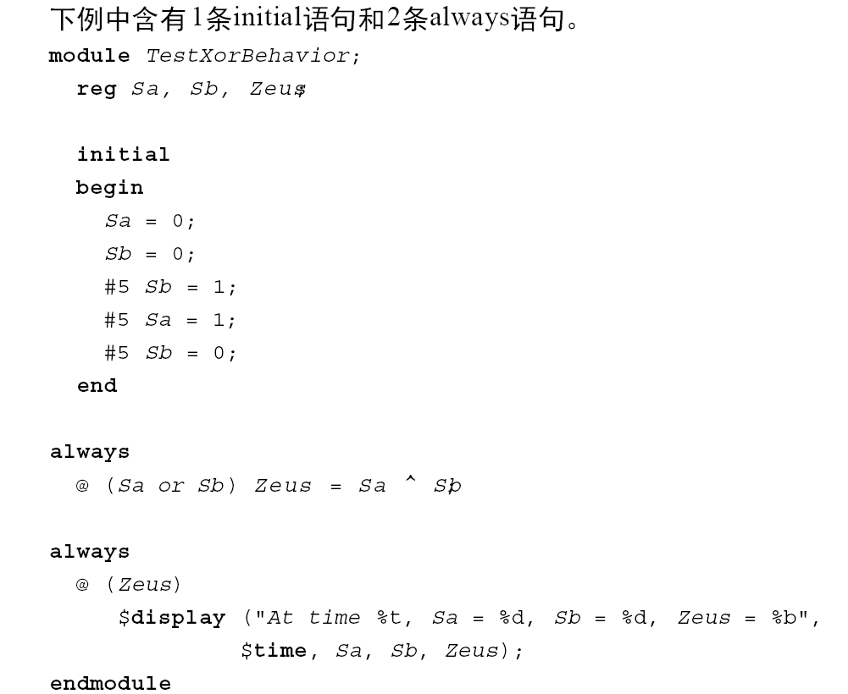
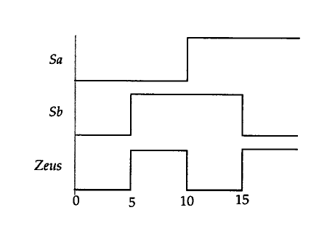
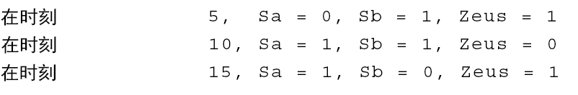
always vs initial
模块中的3条语句并行执行，其在模块中的书写次序并不重要。
Notes:
左边是一次波形；右边不断重复。

Slide 52
always vs initial
reg [7:0] v1, v2, v3, v4;
initial begin
v1 = 1;
#2 v2 = v1 + 1;
v3 = v2 + 1;
#2 v4 = v3 + 1;
v1 = v4 + 1;
#2 v2 = v1 + 1;
v3 = v2 + 1;
end
reg [7:0] v1, v2, v3, v4;
always begin
v1 = 1;
#2 v2 = v1 + 1;
v3 = v2 + 1;
#2 v4 = v3 + 1;
v1 = v4 + 1;
#2 v2 = v1 + 1;
v3 = v2 + 1;
end
What values does each block produce?
  Lets take our best guess
  You can try it youselves in a simulator
Notes:
左边是一次波形；右边不断重复。

Slide 53
Outline
三种描述的举例说明
结构描述
数据描述
行为描述
  Initial
  Always
  条件语句

Slide 54
Example: Comparator
module compare_4bit_behave(output reg A_lt_B, A_gt_B, A_eq_B,
input [3:0] A, B);
always@( ) begin
end
endmodule
Flush out this template with sensitivity list and implementation
Hint: a if…else if…else statement is best for implementation

Slide 55
if-else 条件语句
case 语句
for循环语句
if (条件表达式) 块语句1
else if (条件表达式2) 块语句2
……
else if (条件表达式n) 块语句n
else 块语句n+1
case (敏感表达式)
值1： 块语句1
值2： 块语句2
……
值n： 块语句n
default：块语句n+1
endcase
for (表达式1；表达式2；表达式3）块语句

Slide 56
if…else if…else statement
General forms…
If (condition)
begin
<statement1>;
<statement2>;
end
else
begin
<statement3>;
<statement4>;
end
If (condition)
begin
<statement1>;
<statement2>;
end
else if (condition2)
begin
<statement3>;
<statement4>;
end
else
begin
<statement5>;
<statement6>;
end
If (condition) begin
<statement1>;
<statement2>;
end
Of course the compound statements formed with begin/end are optional.
Multiple else if’s can be strung along indefinitely

Slide 57
How does and if…else if…else statement synthesize?
  Does not conditionally “execute” block of “code”
  Does not conditionally create hardware!
  It makes a multiplexer or selecting logic
  Generally:
    Hardware for both paths is created
    Both paths “compute” simultaneously
    The result is selected depending on the condition
if (func_add)
alu = a + b;
else if (func_and)
alu = a & b;
else
alu = 8’h00;
+
alu
a[7:0]
1
&
0
8
1
b[7:0]
8’h00
0
8
func_and
func_add
Notes:
是用多路选择器来实现if语句
就是用多路选择器来输出if需要输出的，if没有选中的，那么就不输出，但实际信号是有的。

Slide 58
if statement synthesis (continued)
if (a)
func = c & d;
else if (b)
func = c | d;
c
d
1
d
0
q
func
How does this
synthesize?
en
a
b
Latch??
What you ask for is what you get!
func is of type register. When neither a or b are asserted it didn’t not get a new value.
That means it must have remained the value it was before.
That implies memory…i.e. a latch!
Always have an
else to any if to avoid unintended
latches.

Slide 59
case Statements
Verilog has three types of case statements:
  case, casex, and casez
Performs bitwise match of expression and case item
  Both must have same bitwidth to match!
case
  Can detect x and z! (good for testbenches)
casez
  Uses z and ? as “don’t care” bits in case items and expression
casex
  Uses x, z, and ? as “don’t care” bits in case items and expression
Slide taken direct from Eric Hoffman

Slide 60
Case statement (general form)
case (expression)
alternative1 : statement1; // any of these statements could
alternative2 : statement2; // be a compound statement using
alternative3 : statement3; // begin/end
default : statement4 // always use default for synth stuff
endcase
parameter AND = 2’b00;
parameter OR = 2’b01;
parameter XOR = 2’b10;
case (alu_op)
AND : alu = src1 & src2;
OR : alu = src1 | src2;
XOR : alu = src1 ^ src2;
default : alu = src1 + src2;
endcase
Why always have a default?
Same reason as always having an else with an if statement.
All cases are specified, therefore no unintended latches.
Slide taken direct from Eric Hoffman

Slide 61
Using case To Detect x And z
Only use this functionality in a testbench!
Example taken from Verilog-2001 standard:
case (sig)
1’bz: $display(“Signal is floating.”);
1’bx: $display(“Signal is unknown.”);
default: $display(“Signal is %b.”, sig);
endcase
Slide taken direct from Eric Hoffman

Slide 62
casex Statement
Uses x, z, and ? as single-bit wildcards in case item and expression
Uses first match encountered
always @ (code) begin
casex (code) // case expression
2’b0?: control = 8’b00100110; // case item1
2’b10: control = 8’b11000010; // case item 2 2’b11: control = 8’b00111101; // case item 3
endcase
end
What is the output for code = 2’b01?
What is the output for code = 2’b1x?
Slide taken direct from Eric Hoffman

Slide 63
casez Statement
Uses z, and ? as single-bit wildcards in case item and expression
always @ (code) begin
casez (code)
2’b0?: control = 8’b00100110; // item 1
2’bz1: control = 8’b11000010; // item 2 default: control = 8b’xxxxxxxx; // item 3
endcase
end
What is the output for code = 2b’01?
What is the output for code = 2b’zz?
Slide taken direct from Eric Hoffman

Slide 64
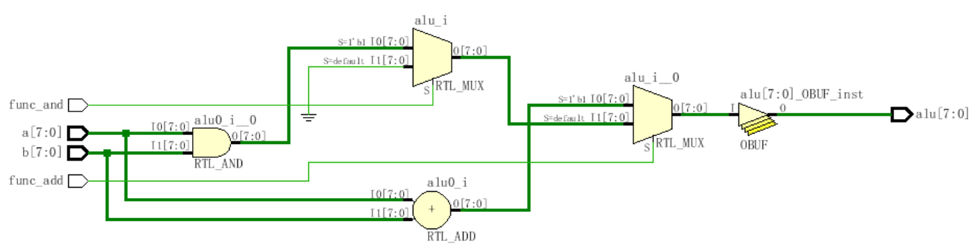
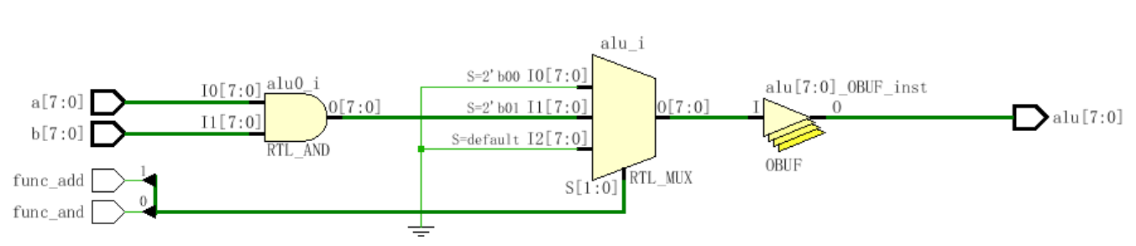
if (func_add)
alu = a + b;
else if (func_and)
alu = a & b;
else
alu = 8’h00;
case({func_add, func_and})
2'b00: alu = 8'h00;
2'b01: alu = a & b;
2'b1x: alu = func_add;
default: alu = 8'h00;
endcase
Notes:
Case和if的区别：
用if描述的语句的延迟输出不一样
用case描述的语句没有优先级，所以延迟输出是一样的
如果信号是一起的来，用case一起出比较好，是同步
如果信号不是一起的来，那么可以用if来让他们的一起出去，尽量实现同步

Slide 65
Outline
三种描述的举例说明
结构描述
数据描述
行为描述
  Initial
  Always
  条件语句
  循环语句

Slide 66
Loops in Verilog
We already saw the for loop:
reg [15:0] rf[0:15]; // memory structure for modeling register file
reg [5:0] w_addr; // address to write to
for (w_addr=0; w_addr<16; w_addr=w_addr+1)
rf[w_addr[3:0]] = 16’h0000; // initialize register file memory
There are 3 other loops available:
  While loops
  Repeat loop
  Forever loop

Slide 67
while loops
Executes until boolean condition is not true
  If boolean expression false from beginning it will never execute loop
reg [15:0] flag;
reg [4:0] index;
initial begin
index=0;
found=1’b0;
while ((index<16) && (!found)) begin
if (flag[index]) found = 1’b1;
else index = index + 1;
end
if (!found) $display(“non-zero flag bit not found!”);
else $display(“non-zero flag bit found in position %d”,index);
end
Handy for cases where loop termination is a more complex function.
Like a search

Slide 68
repeat Loop
Good for a fixed number of iterations
  Repeat count can be a variable but…
    It is only evaluated when the loops starts
    If it changes during loop execution it won’t change the number of iterations
Used in conjunction with @(posedge clk) it forms a handy & succinct way to wait in testbenches for a fixed number of clocks
initial begin
inc_DAC = 1’b1;
repeat(4095) @(posedge clk); // bring DAC right up to point of rollover
inc_DAC = 1’b0;
inc_smpl = 1’b1;
repeat(7)@(posedge clk); // bring sample count up to 7
inc_smpl = 1’b0;
end

Slide 69
forever loops
We got a glimpse of this already with clock generation in testbenches.
Only a $stop, $finish or a specific disable can end a forever loop.
initial begin
clk = 0;
forever #10 clk = ~ clk;
end
Clock generator is by far the most
common use of a forever loop
Notes:
这里是时钟的模拟代码的写法

Slide 70
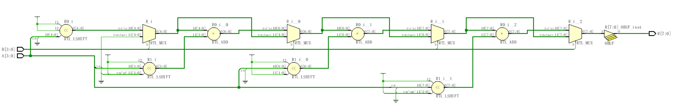
module mult4b(output reg [7:0] R, input [3:0] A, input [3:0] B);
integer i;
always @(A, B) begin
R = 0;
for(i=1; i<=4; i=i+1)
if(B[i-1]) R = R + (A<<i);
end
endmodule
Notes:
Verilog设计尽量不用循环语句，否则硬件成本太高，上图是四套电路的成本，最好做成流水

Slide 71
Verilog组合电路设计

Slide 72
运算器
编码器（带优先级）
译码器
数据选择器
数值比较器

Slide 73
// 1位全加器
module fa_rtl (A, B, CI, S, CO) ;
input A, B, CI ;
output S, CO ;
// use continuous assignments
assign S = A ^ B ^ CI;
assign C0 = (A & B) | (A & CI) | (B & CI);
endmodule

Slide 74
// 1位全加器
module fa_bhv (A, B, CI, S, CO) ;
input A, B, CI;
output S, CO;
reg S, CO; // assignment made in an always block
// must be made to registers
// use procedural assignments
always@(A or B or CI)
begin
S = A ^ B ^ CI;
CO = (A & B) | (A & CI) | (B & CI);
end
endmodule

Slide 75
// 1位全加器
module Add_full(c_out, sum, a, b, c_in) ;
output sum, c_out;
input a, b, c_in;
wire w1, w2, w3;
Add_half AH1(.sum(w1), .c_out(w2), .a(a), .b(b));
Add_half AH2(.sum(sum), .c_out(w3), .a(c_in), .b(w1));
or carry_bit(c_out, w2, w3);
endmodule
Add_full
Add_half
Add_half
or

Slide 76
// 4位全加器
module full_adder(a, b, c, s);
input [3:0] a, b;
output [3:0] s;
output c;
assign {c,s} = a + b;
endmodule

Slide 77
// 多位全加器
module full_adder(a, b, c, s);
parameter WIDTH = 8;
input [WIDTH-1:0] a, b;
output [WIDTH-1:0] s;
output c;
assign {c,s} = a + b;
endmodule

Slide 78
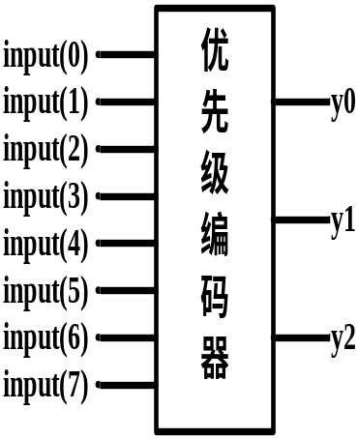
优先级编码器：常用于中断的优先级控制。例如，74LS148是一个8输入，3位二进制码输出的优先级编码器，当其某一个输入有效时，就可以输出一个对应的3位二进制编码。另外，当同时有几个输入有效时，将输出优先级最高的那个输入所对应的二进制编码。
输 入 |  |  |  |  |  |  |  | 二进制编码输出
input(7) | input(6) | input(5) | input(4) | input(3) | input(2) | input(1) | input(0) | y2 | y1 | y0
X | X | X | X | X | X | X | 0 | 1 | 1 | 1
X | X | X | X | X | X | 0 | 1 | 1 | 1 | 0
X | X | X | X | X | 0 | 1 | 1 | 1 | 0 | 1
X | X | X | X | 0 | 1 | 1 | 1 | 1 | 0 | 0
X | X | X | 0 | 1 | 1 | 1 | 1 | 0 | 1 | 1
X | X | 0 | 1 | 1 | 1 | 1 | 1 | 0 | 1 | 0
X | 0 | 1 | 1 | 1 | 1 | 1 | 1 | 0 | 0 | 1
X | 1 | 1 | 1 | 1 | 1 | 1 | 1 | 0 | 0 | 0

Slide 79
module Priority_Encoder(in, y);
input [7:0] in;
output reg [2:0] y;
always @(in) begin
if(in[0]==1'b0) y = 3'b111;
else if(in[1]==1'b0) y = 3'b110;
else if(in[2]==1'b0) y = 3'b101;
else if(in[3]==1'b0) y = 3'b100;
else if(in[4]==1'b0) y = 3'b011;
else if(in[5]==1'b0) y = 3'b010;
else if(in[6]==1'b0) y = 3'b001;
else y = 3'b000;
end
endmodule

Slide 80
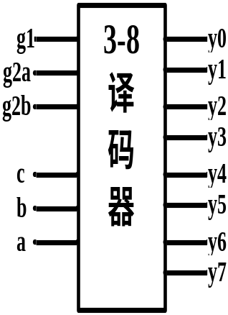
3-8译码器：3-8译码器是最常用的一种小规模集成电路。对输入a、b、c的值进行译码，就可以确定输出端y0～y7的哪一个输出端变为有效，从而达到译码的目的。
选 通 输 入 |  |  | 二进制输入端 |  |  | 译 码 输 出 端
g1 | g2a | g2b | c | b | a | y0 | y1 | y2 | y3 | y4 | y5 | y6 | y7
X | 1 | X | X | X | X | 1 | 1 | 1 | 1 | 1 | 1 | 1 | 1
X | X | 1 | X | X | X | 1 | 1 | 1 | 1 | 1 | 1 | 1 | 1
0 | X | X | X | X | X | 1 | 1 | 1 | 1 | 1 | 1 | 1 | 1
1 | 0 | 0 | 0 | 0 | 0 | 0 | 1 | 1 | 1 | 1 | 1 | 1 | 1
1 | 0 | 0 | 0 | 0 | 1 | 1 | 0 | 1 | 1 | 1 | 1 | 1 | 1
1 | 0 | 0 | 0 | 1 | 0 | 1 | 1 | 0 | 1 | 1 | 1 | 1 | 1
1 | 0 | 0 | 0 | 1 | 1 | 1 | 1 | 1 | 0 | 1 | 1 | 1 | 1
1 | 0 | 0 | 1 | 0 | 0 | 1 | 1 | 1 | 1 | 0 | 1 | 1 | 1
1 | 0 | 0 | 1 | 0 | 1 | 1 | 1 | 1 | 1 | 1 | 0 | 1 | 1
1 | 0 | 0 | 1 | 1 | 0 | 1 | 1 | 1 | 1 | 1 | 1 | 0 | 1
1 | 0 | 0 | 1 | 1 | 1 | 1 | 1 | 1 | 1 | 1 | 1 | 1 | 0

Slide 81
module decoder_38(out,in,g1,g2a,g2b);
output reg [7:0] out;
input [2:0] in;
input g1,g2a,g2b;
always @(in,g1,g2a,g2b) begin
if(g1==1'b1 && g2a==1'b0 && g2b==1'b0)
case(in)
3'd0: out=8'b11111110;
3'd1: out=8'b11111101;
3'd2: out=8'b11111011;
3'd3: out=8'b11110111;
3'd4: out=8'b11101111;
3'd5: out=8'b11011111;
3'd6: out=8'b10111111;
3'd7: out=8'b01111111;
endcase
end
endmodule

Slide 82
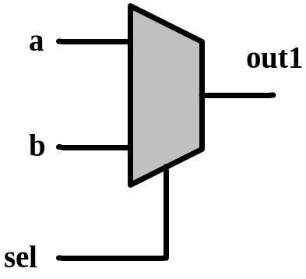
1位数据宽度2选1多路选择器
module mux2_1(out1, a, b, sel) ;
output reg out1;
input a, b;
input sel;
always @(sel or a or b)
begin
if (sel)
out1 = b;
else
out1 = a;
end
endmodule
module mux2_1(out1, a, b, sel) ;
output reg out1;
input a, b;
input sel;
always @(sel or a or b)
begin
case (sel)
1’b0 : out1 = a;
1’b1 : out1 = b;
endcase
end
endmodule

Slide 83
多位数据宽度2选1多路选择器
module mux2_1(out1, a, b, sel) ;
output reg [3:0] out1;
input [3:0] a, b;
input sel;
always @(sel or a or b)
begin
if (sel)
out1 = b;
else
out1 = a;
end
endmodule
module mux2_1(out1, a, b, sel) ;
output reg [3:0] out1;
input [3:0] a, b;
input sel;
always @(sel or a or b)
begin
case (sel)
1’b0 : out1 = a;
1’b1 : out1 = b;
endcase
end
endmodule

Slide 84
4选1多路选择器（用if-else 语句描述）
module MUX4_1(out, in0, in1, in2, in3, sel);
output out;
input in0, in1, in2, in3;
input[1:0] sel;
reg out;
always @ (in0 or in1 or in2 or in3 or sel)
begin
if (sel==2'b00) out=in0;
else if (sel==2'b01) out=in1;
else if (sel==2'b10) out=in2;
else out=in3;
end
endmodule

Slide 85
4选1多路选择器（用case 语句描述）
module MUX4_1(out, in0, in1, in2, in3, sel);
output out;
input in0,in1,in2,in3;
input[1:0] sel;
reg out;
always @ (in0 or in1 or in2 or in3 or sel)
begin
case(sel)
2'b00: out=in0;
2'b01: out=in1;
2'b10: out=in2;
default: out=in3;
endcase
end
endmodule

Slide 86
// 数值比较器
module comparator(A, B, is_equal, is_great, is_less);
parameter WIDTH = 8;
input [WIDTH-1:0] A, B;
output is_equal, is_great, is_less;
assign is_equal = (A==B)? 1'b1 : 1'b0;
assign is_great = (A>B)? 1'b1 : 1'b0;
assign is_less = (A<B)? 1'b1 : 1'b0;
endmodule

